Slide 1
Data Analytics Projects
Data Analysis & Data Visualization

Slide 2
Project Key-points
Excel Dashboard
Use Pivot table & pivot charts
Use some count & sum functions
Use Filters & Slicers

Slide 3
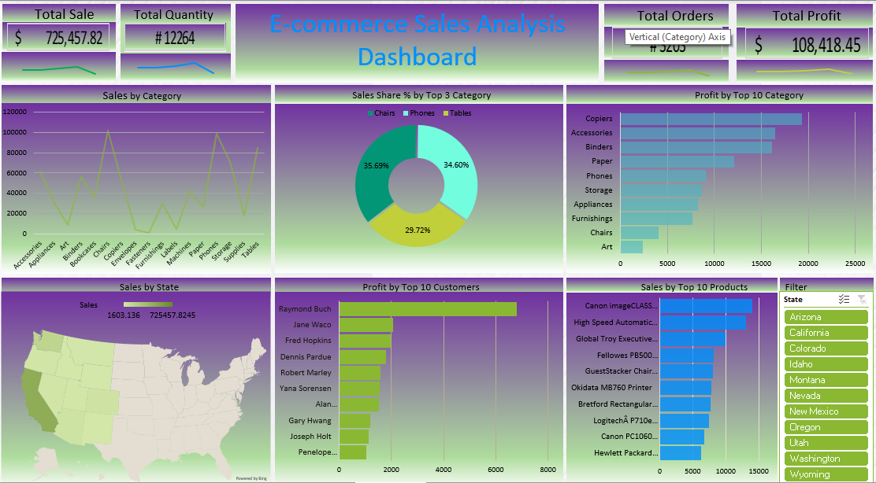
E-Commerce Data Analysis Dashboard

Slide 4
Project Key-points
Sales Insights Project – Using SQL
Analyse Data with SQL queries & functions.
Visualize Data with Power BI
Uses WHERE CLAUSE
GROUP BY
ORDER BY
JOINS CLAUSE
AGGRIGATIVE FUNCTION
WINDOW FUNCTION & LIMIT.

Slide 5
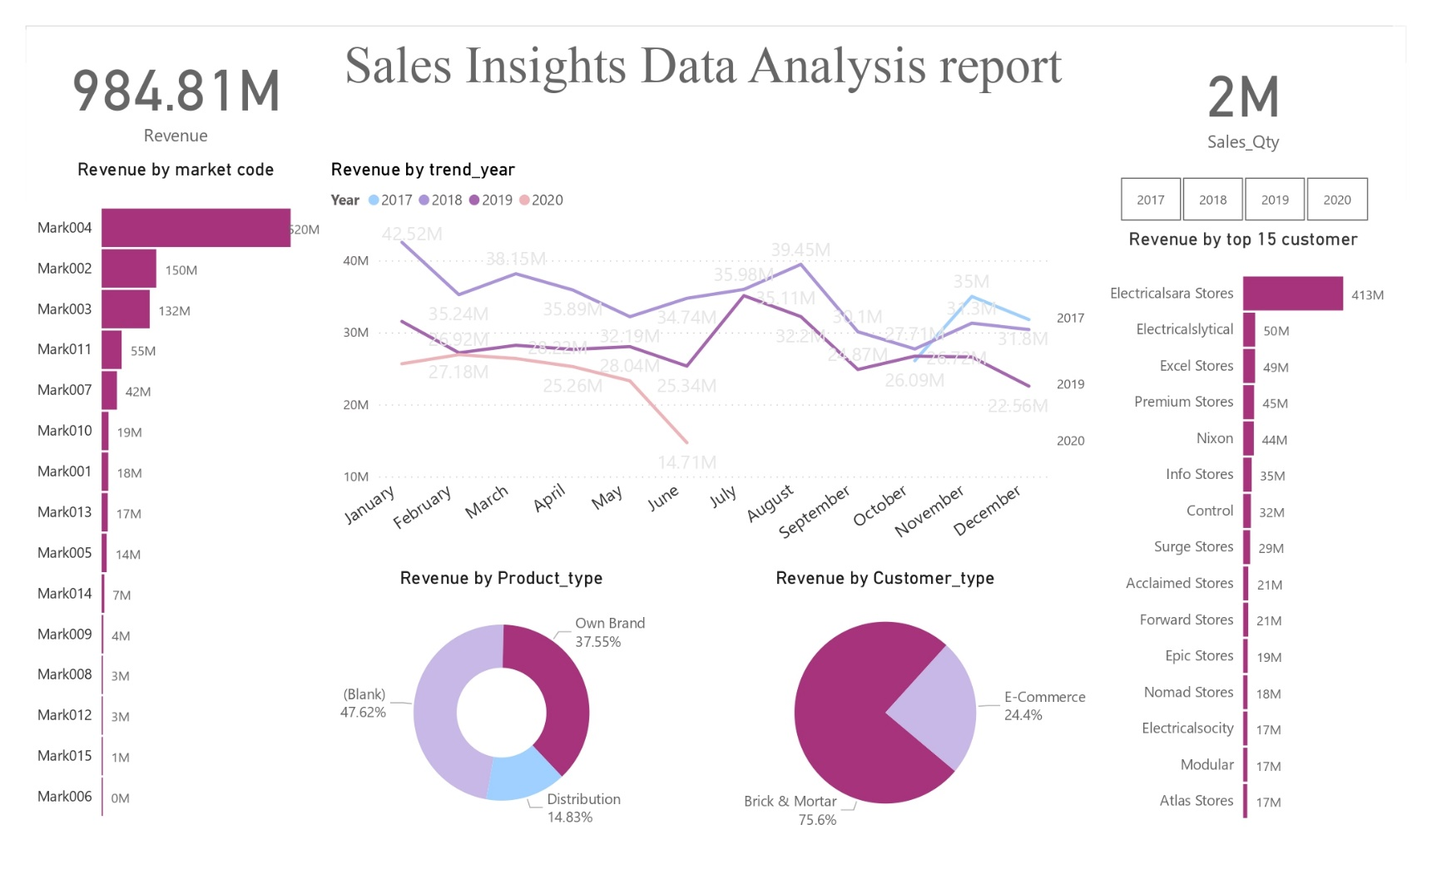
Sales Insights Dashboard

Slide 6
Project Key-points
Netflix movies & TV shows data analysis
Data Analyse & Data Visualise with Power BI
Used DAX Queries (COUNTX FUNCTION)
Analyse number of movies & TV shows released per year by Netflix
Explore ratings of movies & TV shows
Top 10 Actors & Directors & viewed genres
Analyse top 5 movies and shows on Netflix

Slide 7
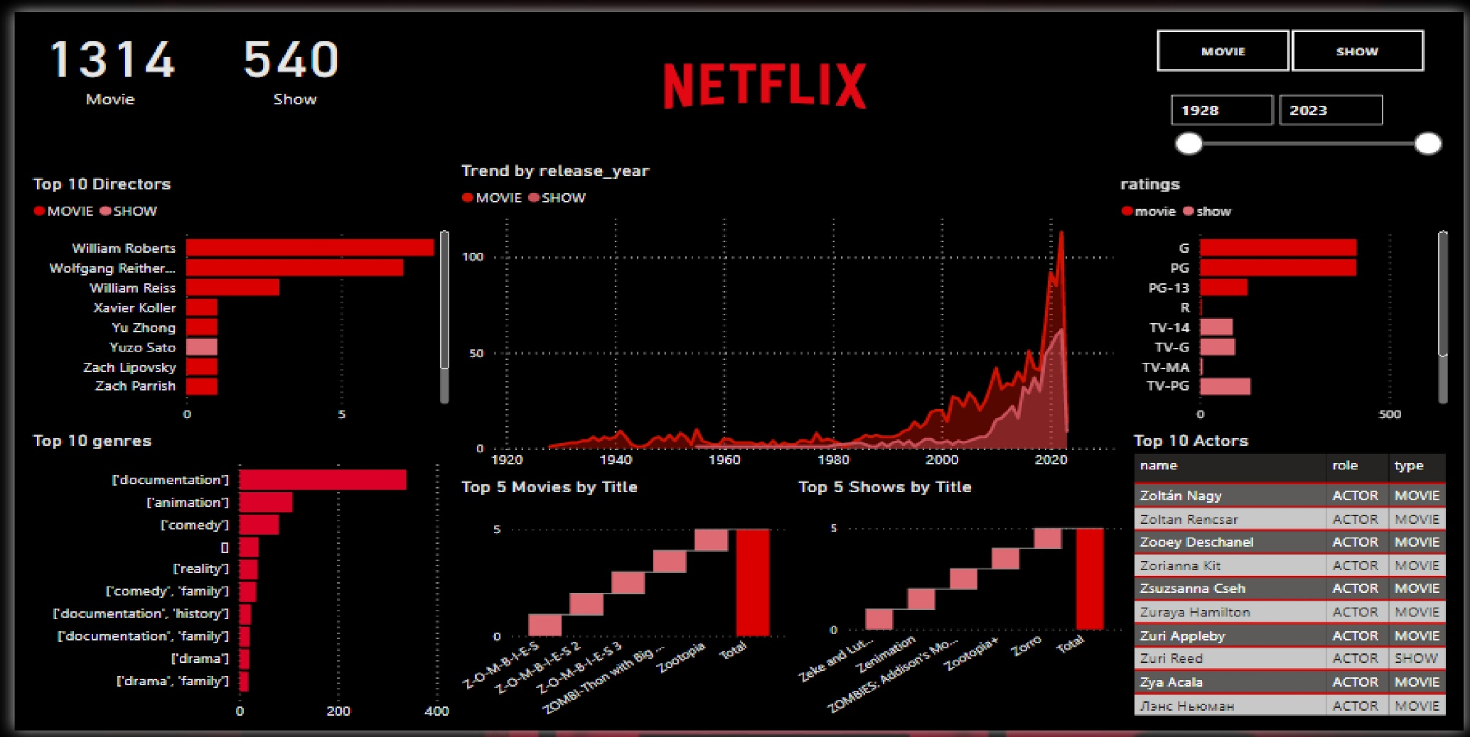
Netflix Data analysis Dashboard

